Slide 1
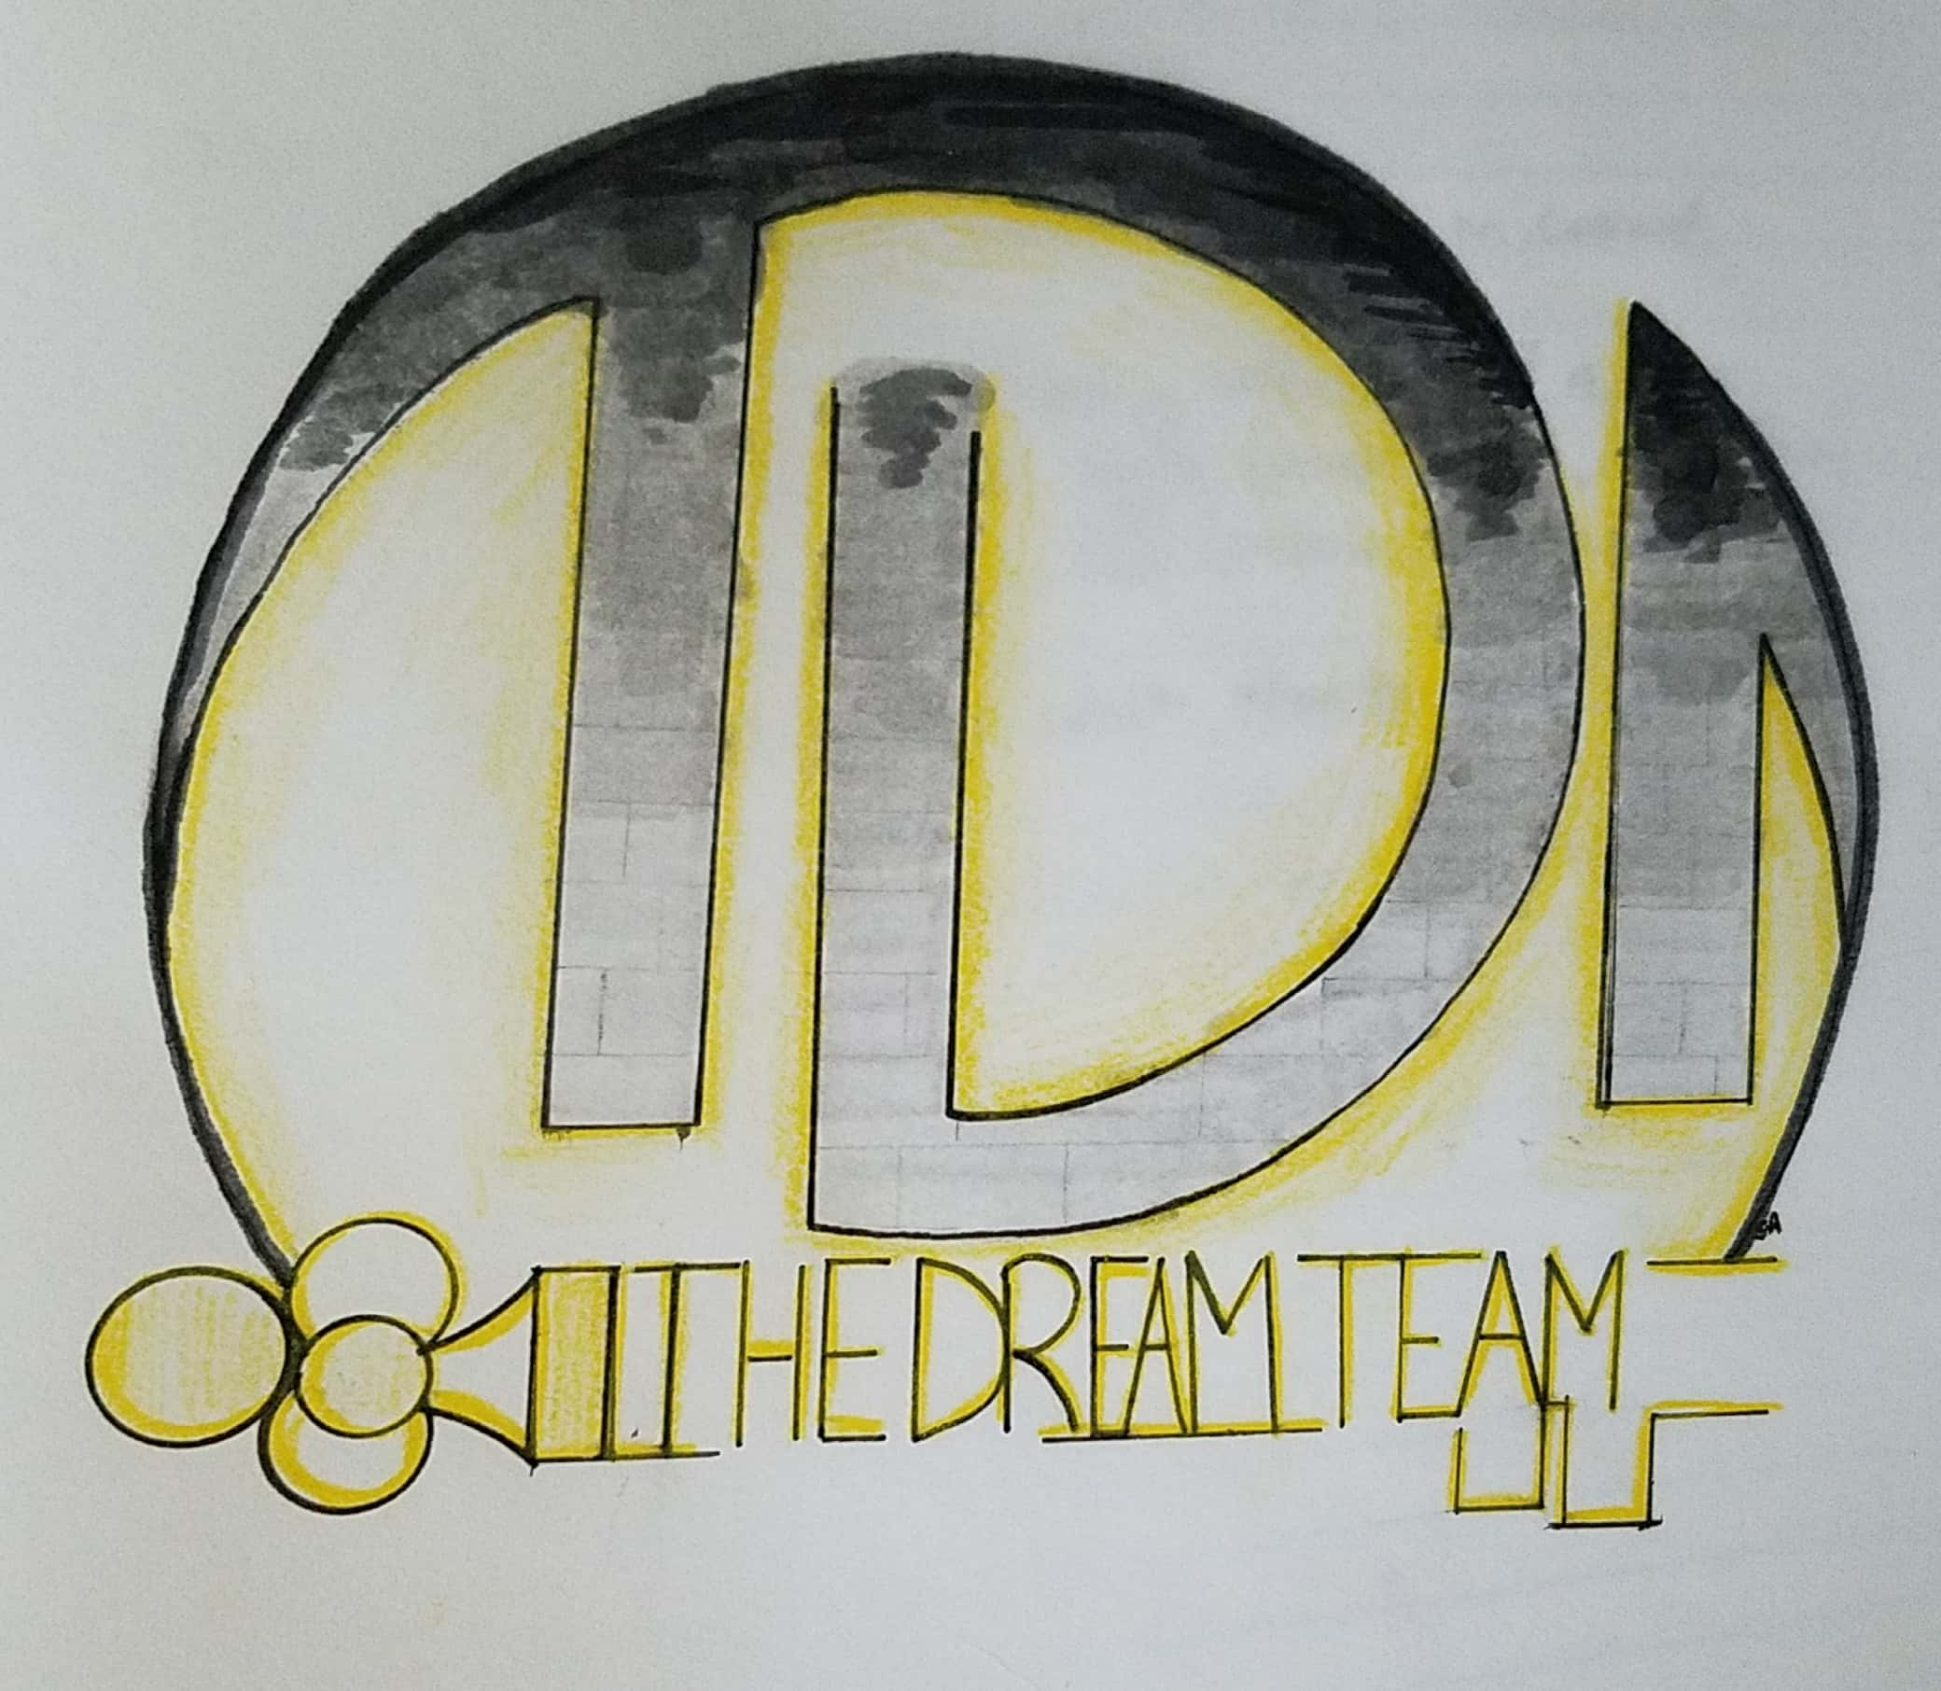
Dream Team
Chasing the End

Slide 2
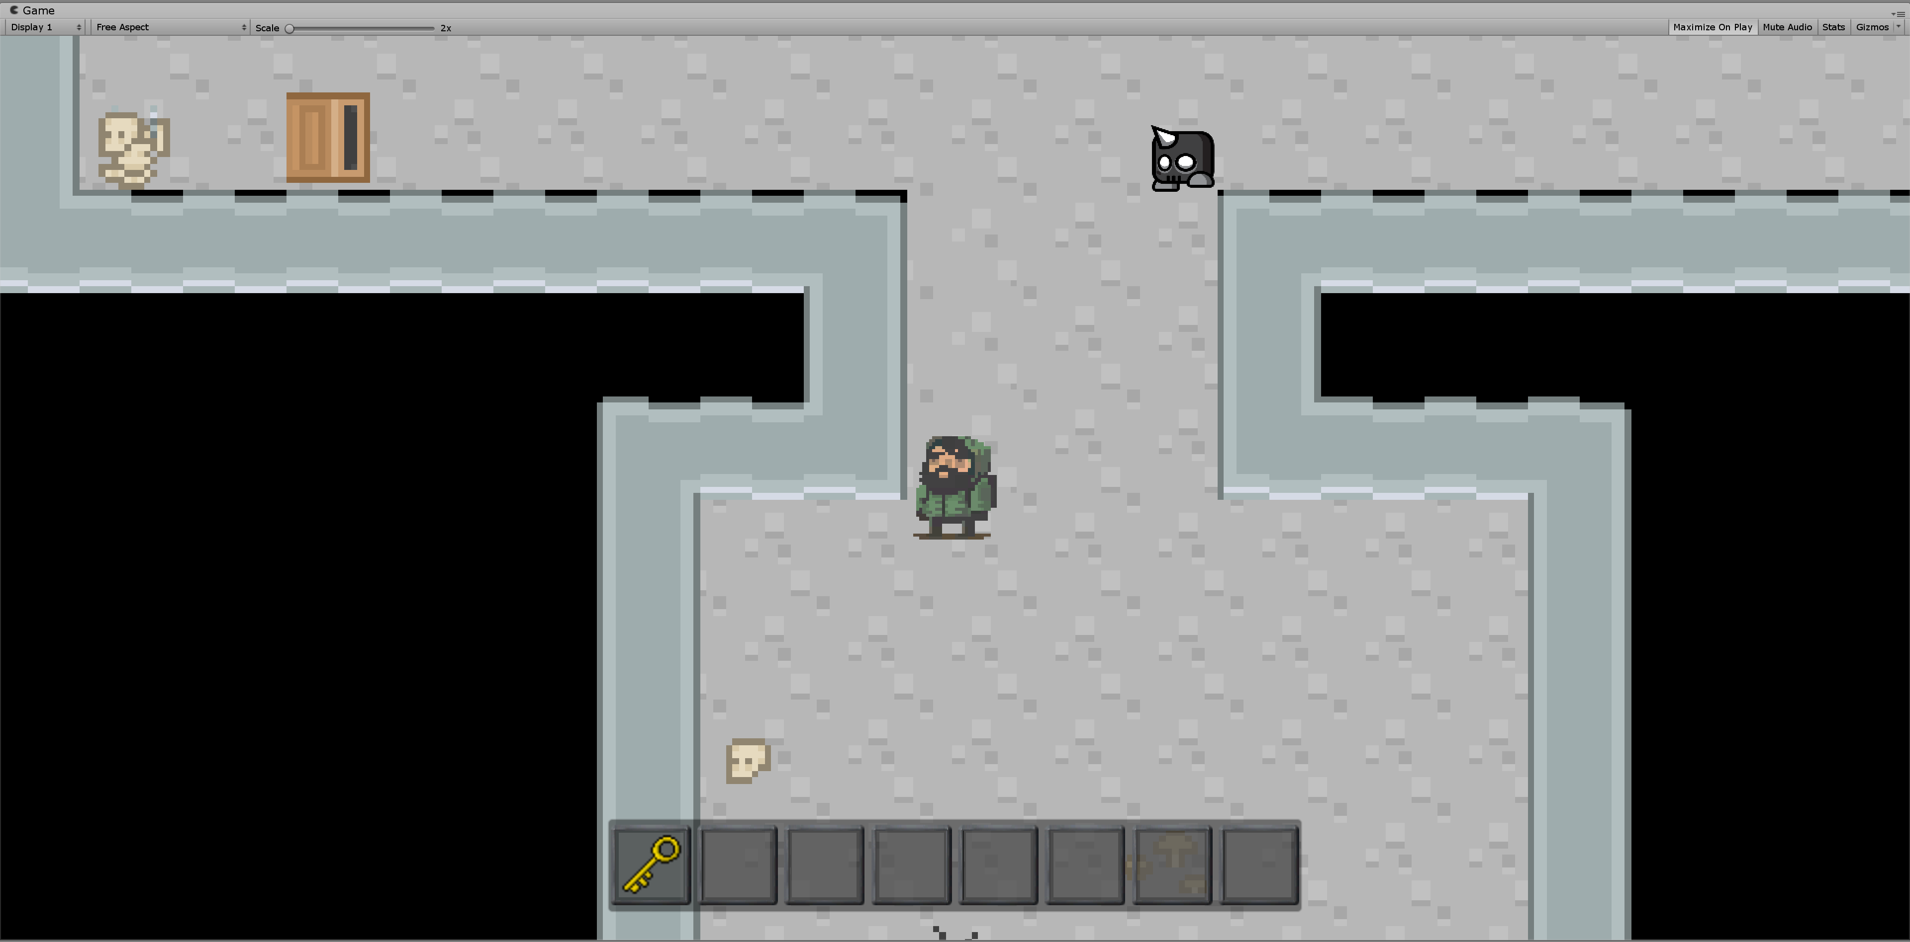
Chasing the End
Tyler
Jorge
Edgar
Brad

Slide 3
In terms of GRASP was this a good breakdown?
Maintainability, Extendibility, Modularity
Good software design has high cohesion and low coupling
Cohesion: refers to what the class (or module) can do
Coupling: refers to how related or dependent two classes/modules are toward each other

Slide 4

Outstanding feature that could use a pair-programing team
JSON Save File
Loading from JSON

Slide 5
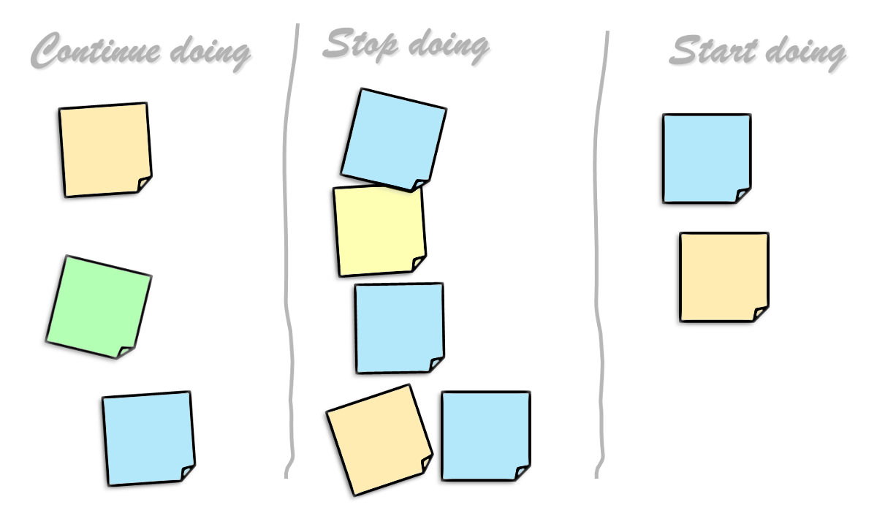
If you were given the project to do again, how would you break it down next time?

Slide 6
what other things would you change in this course to enhance the learning experience?
BBLearn content organization
Deliverable clarity
Shared code concepts
Code reviews
Git organization
Project management

Slide 7
Any Questions?

